Slide 1
MIPS Processor
By: Calvin Passmore
ECE 6470
Dr. Sanghamitra Roy
April 25, 2023

Slide 2
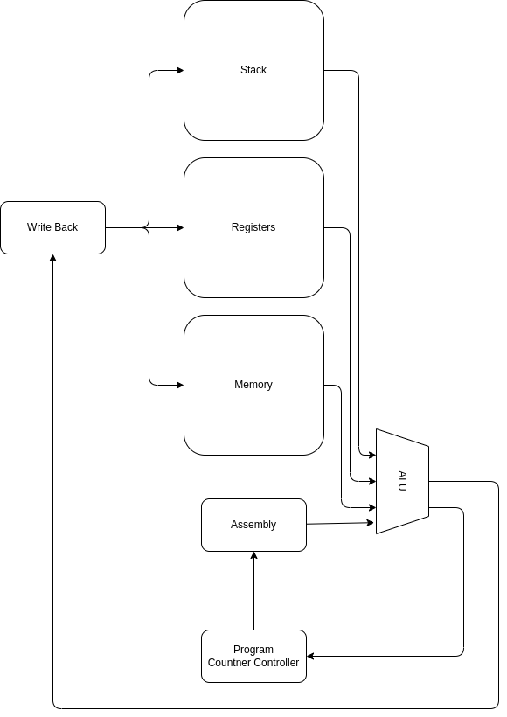
Block Diagram

Slide 3
Specification
Name | OpCode | Meaning | DESTINATION | SOURCE 1
NOOP | 0x0 | Do nothing | - | -
LOAD | 0x1 | Load from memory into a register | Destination Register | -
LDNM | 0x2 | Load a scalar into the register | Destination Register | -
STR | 0x3 | Store from the register to memory | Memory Address | -
ADD | 0x4 | Add two registers | Destination Register | Source Register 1
SUB | 0x5 | Subtract two registers | Destination Register | Source Register 1
XOR | 0x6 | XOR two registers into a single register | Destination Register | Source Register 1
AND | 0x7 | AND individual bits in two registers into one register | Destination Register | Source Register 1
JMP | 0x8 | Jump to address | Jump address | -
JMP0 | 0x9 | Jump to address if the given register is not 0 | Jump address | -
PUSH | 0xA | Push the register value onto the stack | - | -
POP | 0XB | Pop the top value off the stack | Destination Register | -

Slide 4
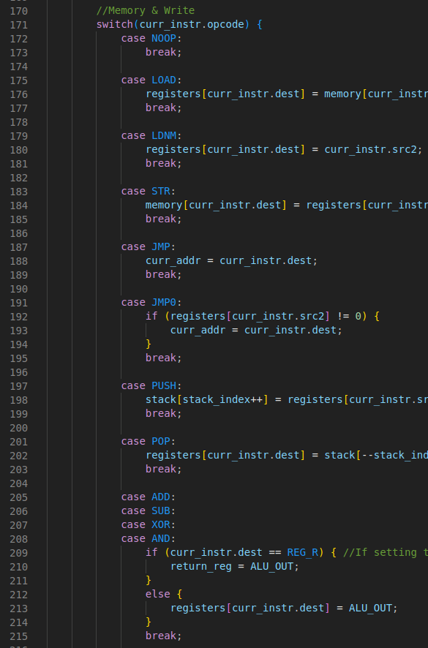
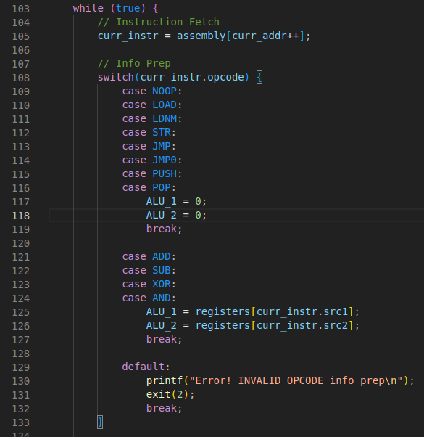
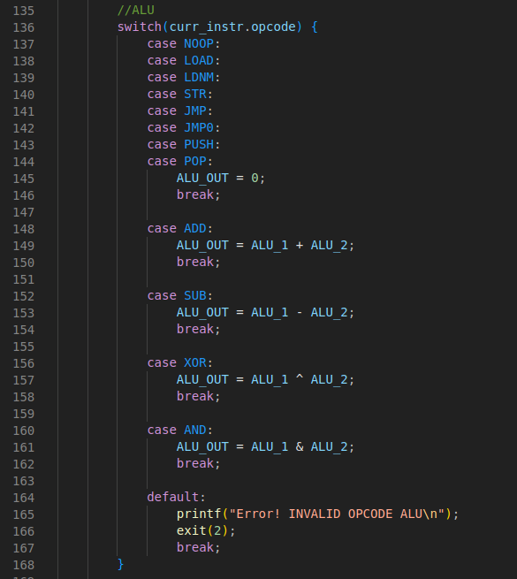
Golden Model

Slide 5
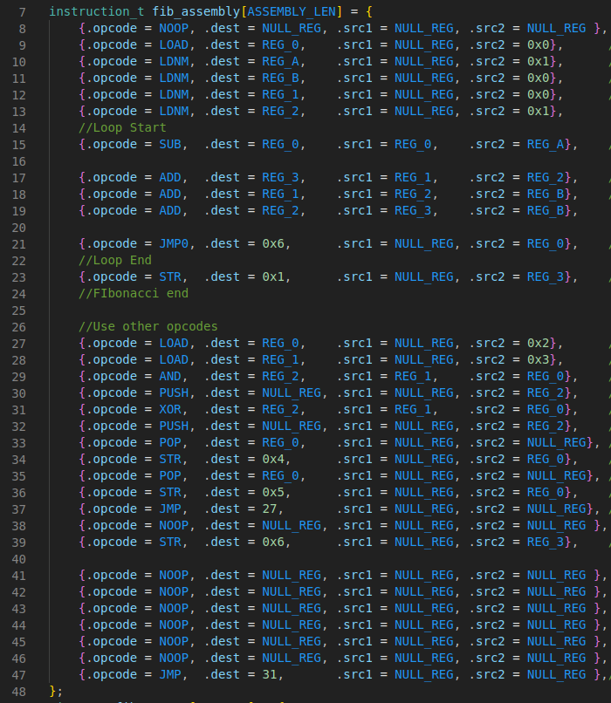
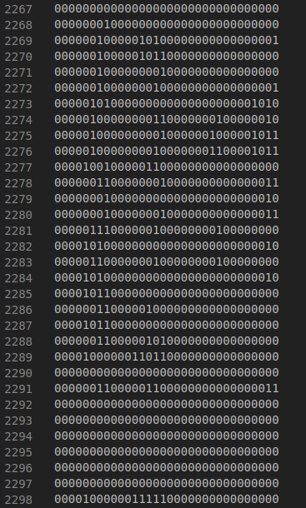
Outputting Assembly

Slide 6
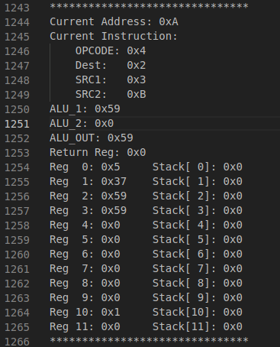
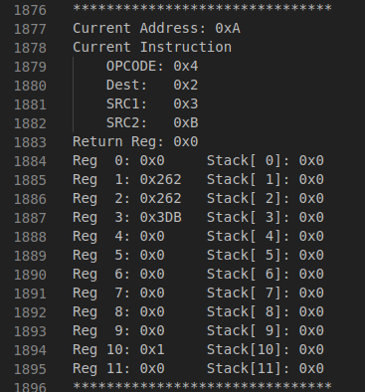
Simulation Results
Notes:
Golden Model on the left, Cocotb on the right

Slide 7
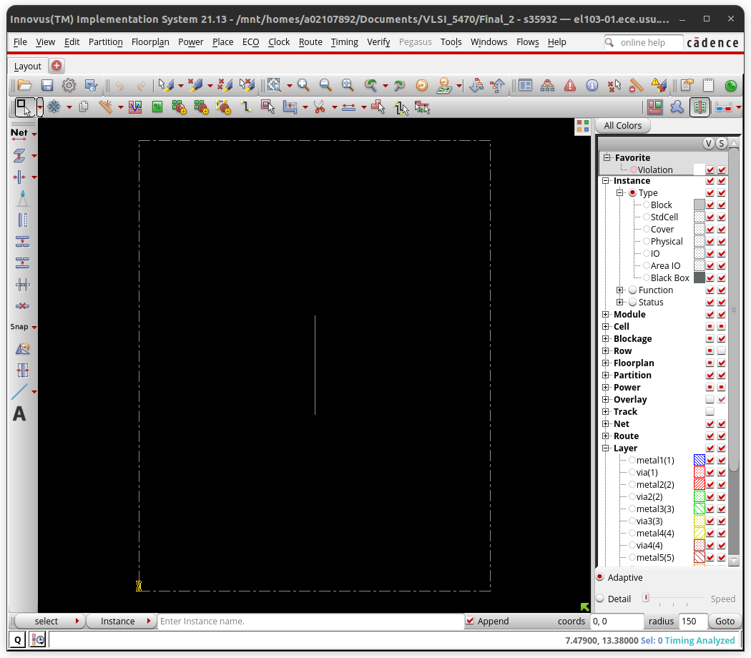
Floorplanning

Slide 8
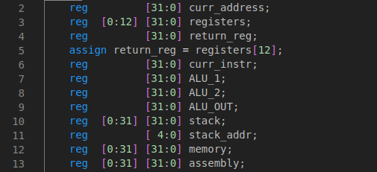
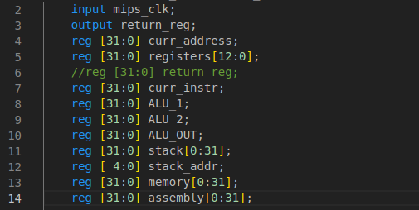
Issues

